Slide 1
Health Literacy Training for Public Library Staff
Patricia Garret, Health and Wellbeing Officer at Portsmouth City Council, worked with Library and Knowledge Specialists at Portsmouth NHS Trust to design and deliver a training session for the dissemination of health literacy resource training to public library staff.
As a result of this training, most of Portsmouth Library Services frontline staff are now equipped to support customers when looking for up to date, good quality health information.
Increasing the skills and confidence of public library staff has improved supported access to health information for people in the community, particularly individuals with low health literacy.
www.hee.nhs.uk/lks
Fari Mashumba, Library and E-Learning Manager, Portsmouth NHS Trust
Librarians and Knowledge Specialists bring the evidence to inform healthcare decisions.
Underpinning innovation; enabling knowledge transfer and collaborative working.

Slide 2
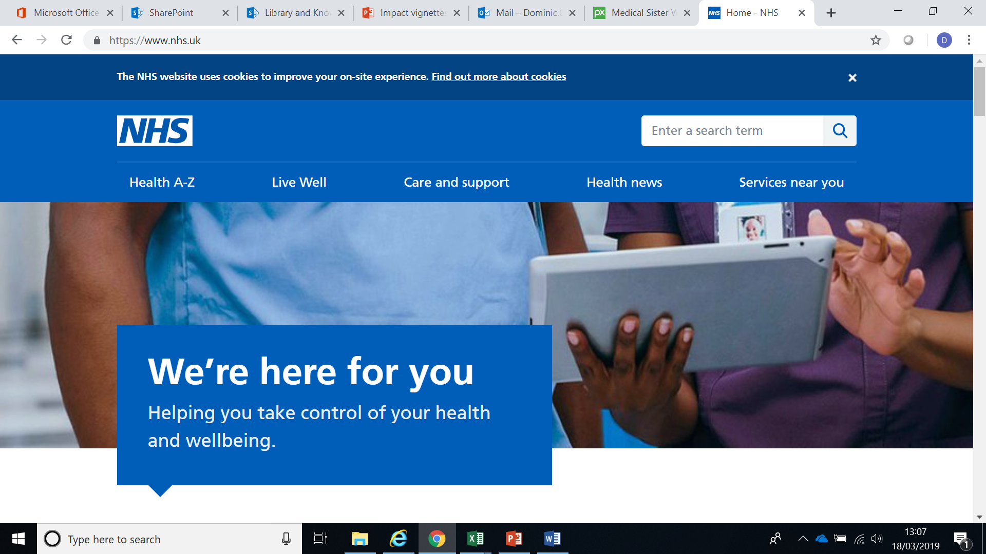
Health Information Literacy training for members of the public in collaboration with local public libraries
Library and Knowledge Specialists from Royal Brompton & Harefield NHS Foundation Trust and The Hillingdon Hospitals NHS Foundation Trust worked with Public Library staff at Hillingdon Council to cascade training around NHS website.
This increased the awareness and confidence of Public Library staff in navigating the site and their ability to signpost members of the public appropriately.
I was not aware of NHS Choices till today. I was very impressed with the choices available.
Feel more confident in promoting this to the public.
Public Library staff at Hillingdon Council, working with the library professionals at Royal Brompton & Harefield NHS Foundation Trust and The Hillingdon Hospitals NHS Foundation Trust.
#AMillionDecisions
www.hee.nhs.uk/lks
Librarians and Knowledge Specialists bring the evidence to inform healthcare decisions.
Underpinning innovation; enabling knowledge transfer and collaborative working.

