Slide 1
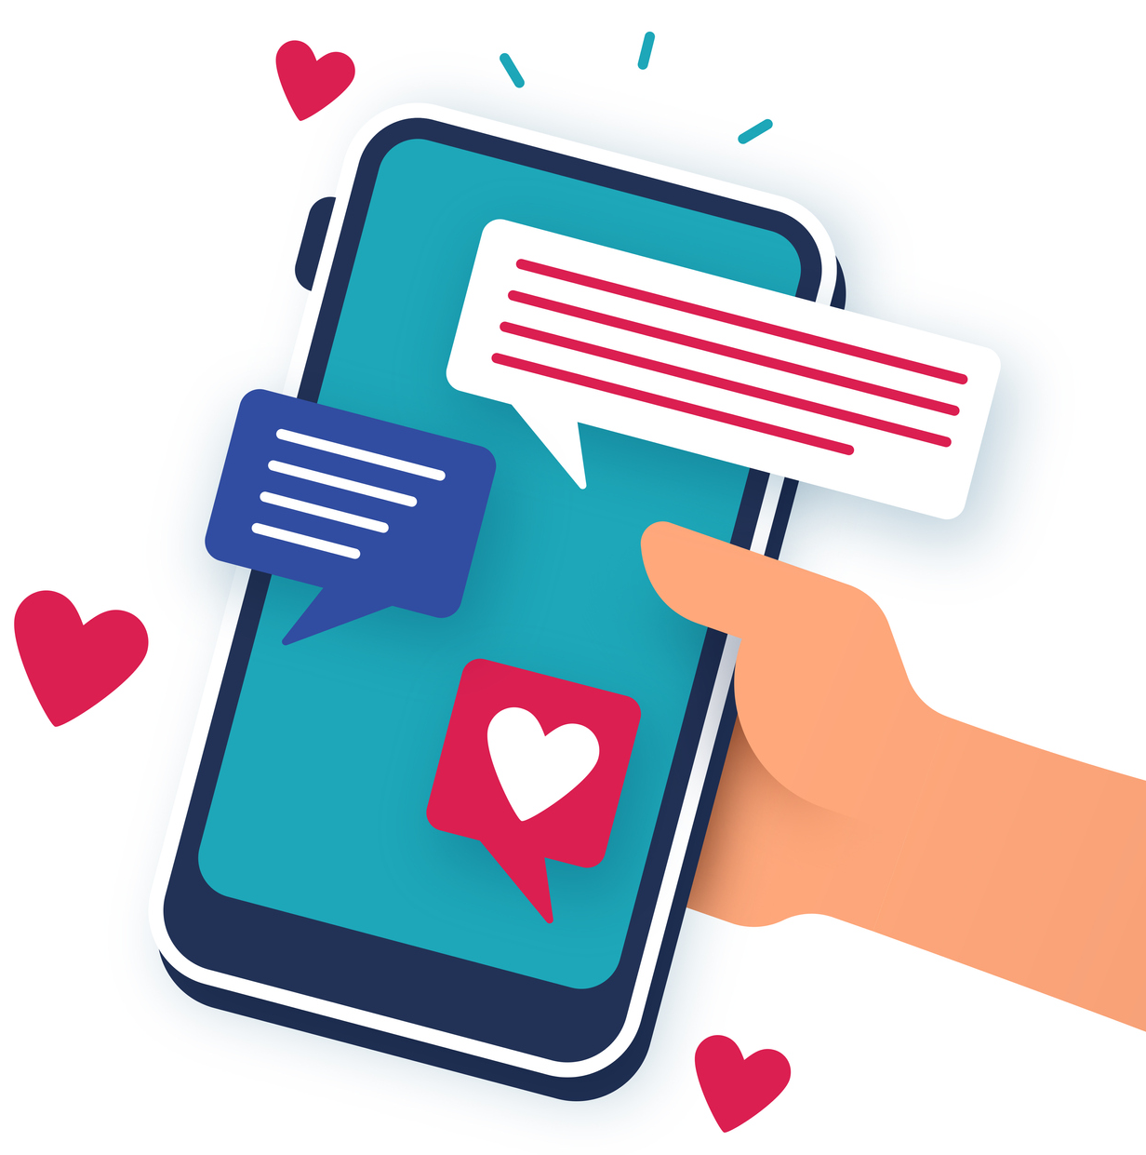
Public libraries
resource pack
NHS account and NHS App

Slide 2
What is the partnership?
This partnership between NHS England and NHS Knowledge and library service and public libraries goes live end October 2024 to embed digital inclusion, so that people can access their own health information using their NHS Account, locally and in a trusted environment.
We know it is important to build trust when talking to people about technology, data and their healthcare and records. Libraries already play a vital role in making online services more accessible and according to a 2024 survey by Ipsos, librarians are the third most trusted profession in Britain.
Resources are available online so you can help people to use the NHS App and or log in to their NHS account using the NHS.UK.
We want to promote this new partnership so the public and patients understand the benefits of using their NHS account or the NHS App to better understand their personal health and to be more involved in their care.

Slide 3
Digital inclusion
2.1 million people who are offline, are older, with a health condition and have no formal qualifications.
5.2 million (10%) who have low digital skills, and 13 million (25%) who have very low digital skills, are older and from more socioeconomically deprived communities.
60+ adults are almost twice as likely as those aged between 50-59 to lack confidence in their ability to use the Internet

Slide 4
Resources toolkit
Information and resources available to help you
read more about the initiative.
learn more about the NHS account.
learn how to help members of the public.
watch short walkthrough videos
Click on this link to read more about the initiative
Click on this link to watch a short film which gives you an overview of the NHS App and your NHS account
Click on this link to access the training resources
Click on this link to watch short videos which will show you how to use the different features available on the NHS account

Slide 5
Practical tips
Feedback from health ambassadors based in libraries
If you have a tech buddy in your library, work together as they should be able to help you with any potential technical difficulties
Have an appointment booking system so you can let people know what they will need to bring with them to set up or access their account for example, their NHS number, a mobile phone - if they don’t have a mobile phone then they may need to visit their GP to help them set up an account.
Make sure everyone in your team knows about the project, how you are running it and who is your main point of contact
If in doubt, read the FAQ’s on this webpage
https://library.nhs.uk/health-information/public-libraries/

Slide 6
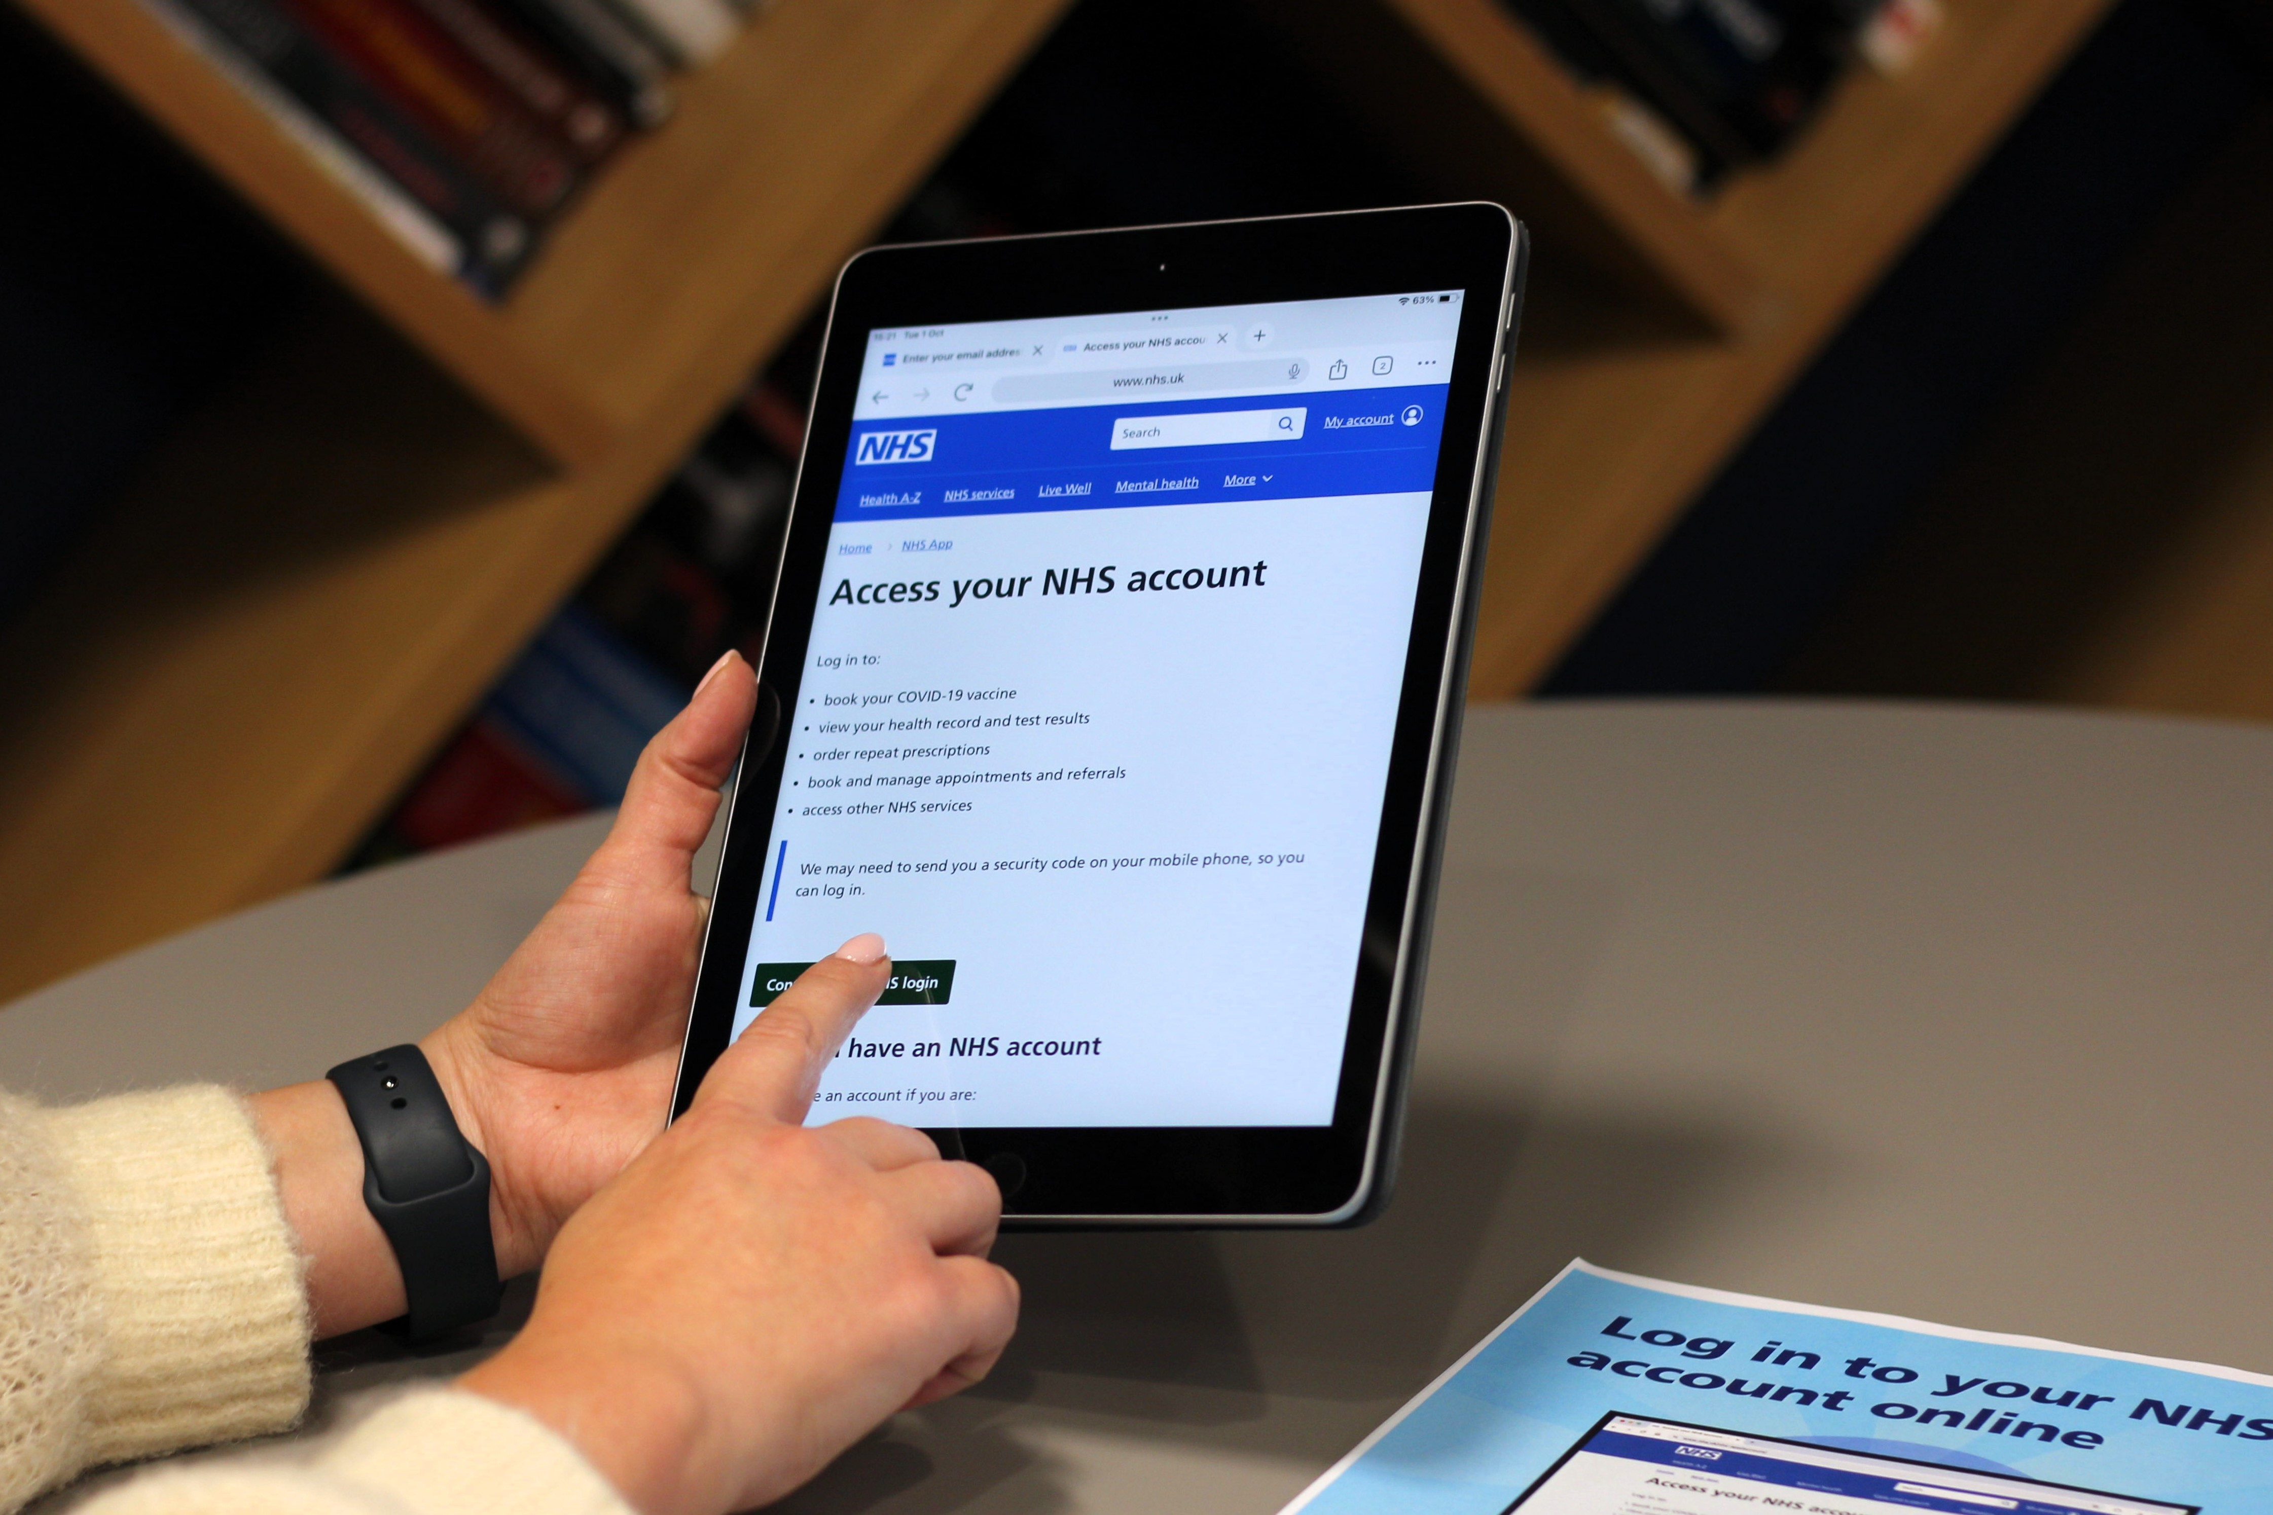
Top ways to help
Publish the key messages on your library homepage, you can use any of the images in this document (open source images)
Download promotional materials, print posters and leaflets. This is the link
Add screensavers to your library computers. This is the link
Add a shortcut to the NHS libraries toolkit webpage to all library computers. This is the webpage to add
Use this email address to contact us if you need help england.kfh@nhs.net
You can log in to your NHS account online at your local library

Slide 7
Social media posts
Promote and encourage the initiative
The next few slides have bulletin copy, social media example posts for you to customise for your own library and share on your social media platforms.

Slide 8
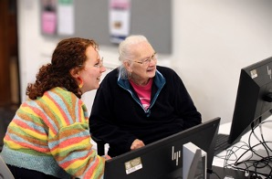
Social media posts
Example post for Facebook
Did you know that you can use the NHS App online at (Library Name)?
Use our library computers/desktops/laptops to log into your NHS Account,
where you can order repeat prescriptions, view your GP record and much more.
You can also use our free Wi-Fi to use the NHS App on your smart phone.
www.nhs.uk/nhs-app/account/
#NHS App
Example post for Instagram
Did you know that you can use the NHS App services online at (Library Name)?
Use our library computers/desktops/laptops to log into your NHS Account,
where you can order repeat prescriptions, view your GP record and much more.
You can also use the free Wi-Fi that libraries provide to use the NHS App on your smart phone.
www.nhs.uk/nhs-app/account/
#NHSApp

Slide 9
Social media posts
Example post for Twitter/X
Did you know that you can use the NHS App online at your local library?
Visit your library to log into your NHS Account on a desktop or laptop, where you can order repeat prescriptions, view your GP record and much more.
www.nhs.uk/nhs-app/account/
#NHSApp
Example post for LinkedIn
Librarians are able help people to use the NHS App and NHS.UK to better understand and manage their health.
The NHS App gives access to online services including accessing health advice, booking appointments and ordering repeat prescriptions. Patients can read their records at a time that suits them, and improves communication between patients and practices, and reduces the need to contact your practice for instance for test results
You can also use free Wi-Fi that libraries provide to use the NHS App on your smart phone.
www.nhs.uk/nhs-app/account/
#NHSApp

Slide 10
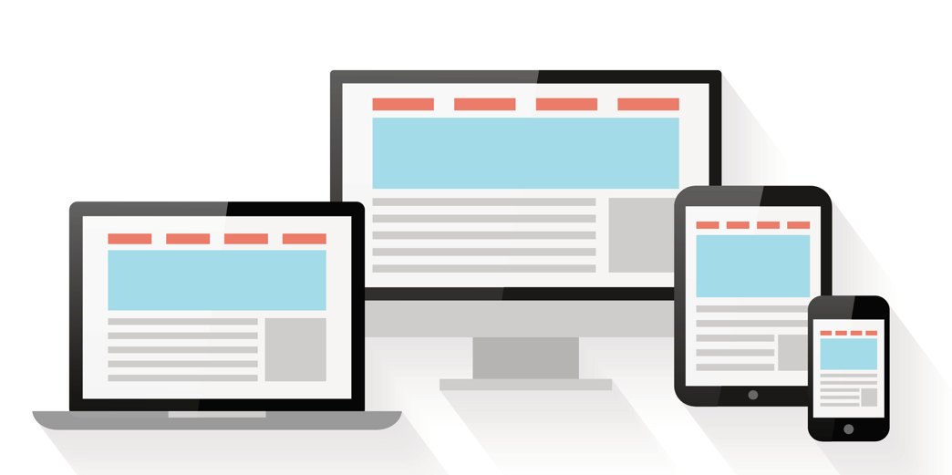
Example long copy (c. 250 words)
This can be used for bulletins/websites/press releases, depending on your activity.
NHS App: improving access to online health services through libraries
273 words:
NHS England is working with libraries to help more people use online health services through the NHS App and NHS.UK.
The pilot, which started in October, builds on existing health literacy programmes in NHS libraries and public libraries across England. It aims to increase digital health inclusion and support the NHS Long Term Plan's goal to reduce healthcare inequalities.
Working with The National Health Literacy Partnership, the initiative leverages libraries' trusted position in communities, offering a sustainable and accessible way for everyone to benefit from NHS services. Library staff will receive toolkits and guidance to help people use the NHS App and the NHS website. Both the App and website allow people to securely access their NHS account and use the same services.
The NHS App has more than 34.3 million registered users. The scheme aims to increase the confidence of both library staff and the public to use NHS digital services.
Using the NHS App or NHS.UK, people can view their GP record, order repeat prescriptions, and look up health information. This offers greater convenience and helps communication between patients and healthcare staff. It also empowers people to take a more active role in managing their health.
Public libraries are supportive, safe spaces where people can use computers and the internet for free. This initiative recognises their vital role in helping people feel more confident using digital health services.
The NHS App is becoming a digital front door for healthcare. New features and connected services are being added to provide a joined-up experience across different health settings, including GPs, pharmacies, and hospitals.
For more information on using the NHS account, visit www.nhs.uk/nhs-app

Slide 11
Example short copy (c. 100 words)
This can be used for bulletins/websites/press releases, depending on your activity.
NHS England working with libraries to bridge digital health divide
104 words:
NHS England is collaborating with libraries to improve access to online health services. Launched in October, this initiative aims to build on existing health literacy programmes and increase digital health inclusion.
Libraries will receive toolkits and guidance to help people use the NHS App and NHS.UK. These online services enable people to view their GP records, order repeat prescriptions, and more.
This initiative recognises libraries as trusted, accessible spaces where anyone can use computers and the internet for free. It supports the NHS Long Term Plan's goal to reduce healthcare inequalities and empowers people to take a more active role in managing their health. https://digital.nhs.uk/services/nhs-app/toolkit/libraries.
NHS England partners with libraries to improve digital health access
42 words:
NHS England is partnering with libraries to improve access to online health services through the NHS App and NHS.UK. This pilot aims to increase digital health inclusion and empower people to take a more active role in managing their health. Visit: https://digital.nhs.uk/services/nhs-app/toolkit/libraries.

Slide 12
URL links
These are the URLs in this document
This is the URL to read about the initiative
https://library.nhs.uk/health-information/public-libraries/
This is the URL to watch the walkthrough videos
https://digital.nhs.uk/services/nhs-app/toolkit/libraries/nhs-account-on-the-nhs-website-walk-through-videos
This is the URL to watch a short video about the NHS account / NHS App
https://www.youtube.com/watch?v=PgxPiHb3OMQ
This is the URL to access the training resources
https://digital.nhs.uk/services/nhs-app/toolkit/libraries

Slide 13
Get in touch!
Thank you for supporting this important initiative to make sure all people have the digital skills to access their health information online.
We’d love to hear back from you, so please share communications and promotional examples of your work with us.
You can use this email joanna.mckibben@nhs.net
If you have any questions or need help england.kfh@nhs.net

